Slide 1

第H组
杨紫城、马宇恒、肖一鸣、吕子康

Slide 2
Catalog
01
Introduction
02
Test Result
03
Analysis
Toric Code
MWPM Decoder
Blossom Algorithm
Error Threshold
Time Complexity
Limit
Comparison

Slide 3
01
Introduction
Toric Code
MWPM Decoder
Blossom Algorithm

Slide 4
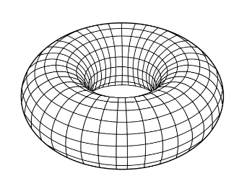
Toric Code
The 'toric' comes from its periodic boundary conditions, which give it the shape of a torus, or a doughnut shape.

Slide 5
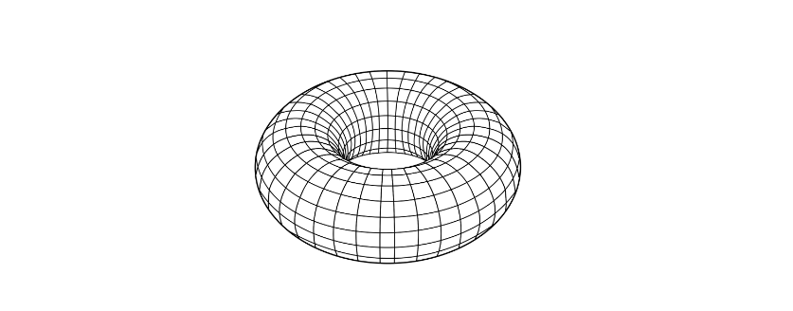
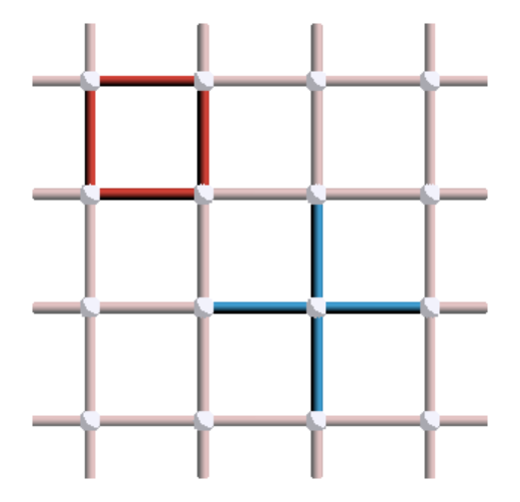
The Surface Code & Toric Code
In a practical setup, some experimental implementations require open boundary conditions, making the system to be embedded on a 2D surface.
The result is usually referred to as the surface code, which behaves similarly to the toric code in most (but not all) cases.

Slide 6
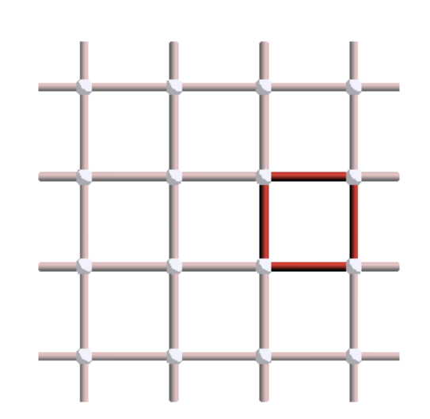
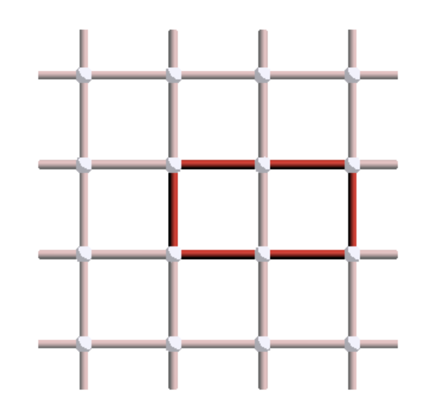
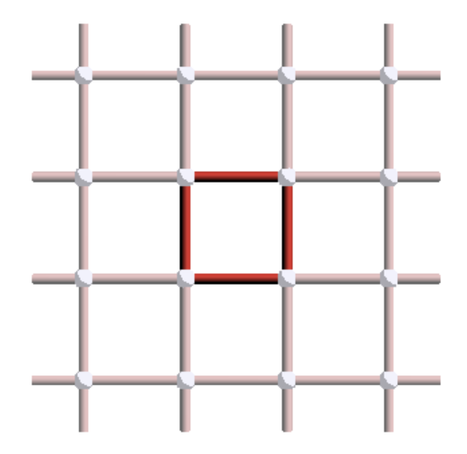
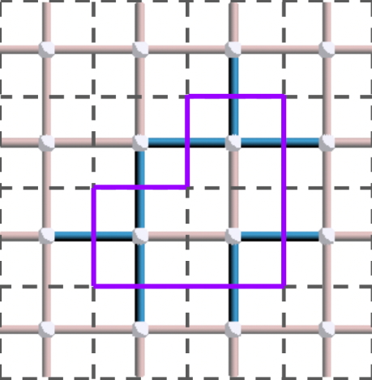
The Surface Code
How to define a surface code?
Qubits → edges, Stabilizers → vertices
Size: L×L, while the number of qubits is n=L×L×2
the vertex stabilizers → every vertex of the lattice as a cross of four Z operators
the plaquette stabilizers → every face as a square of four X operators
The product of stabilizers also a stabilizer. They'll form a loop.
×
=

Slide 7
The Problem
Physical qubits in surface code(or toric) can get flip error or phase error. So we need stabilizers to catch the syndrome.
But how to make correction from the syndrome graph ? ----- it’s the task of decoder.

Slide 8
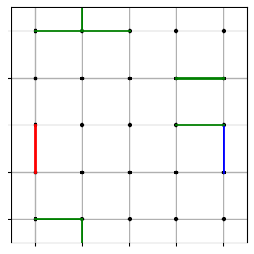
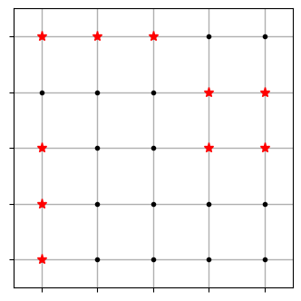
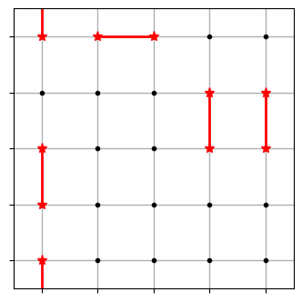
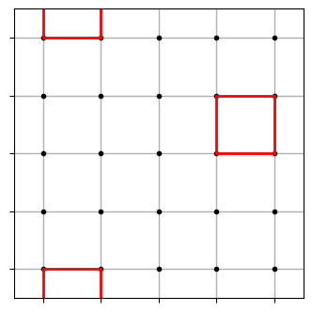
Surface code decoders
Introduce errors
Plot syndromes
Match the syndromes
Get the result

Slide 9
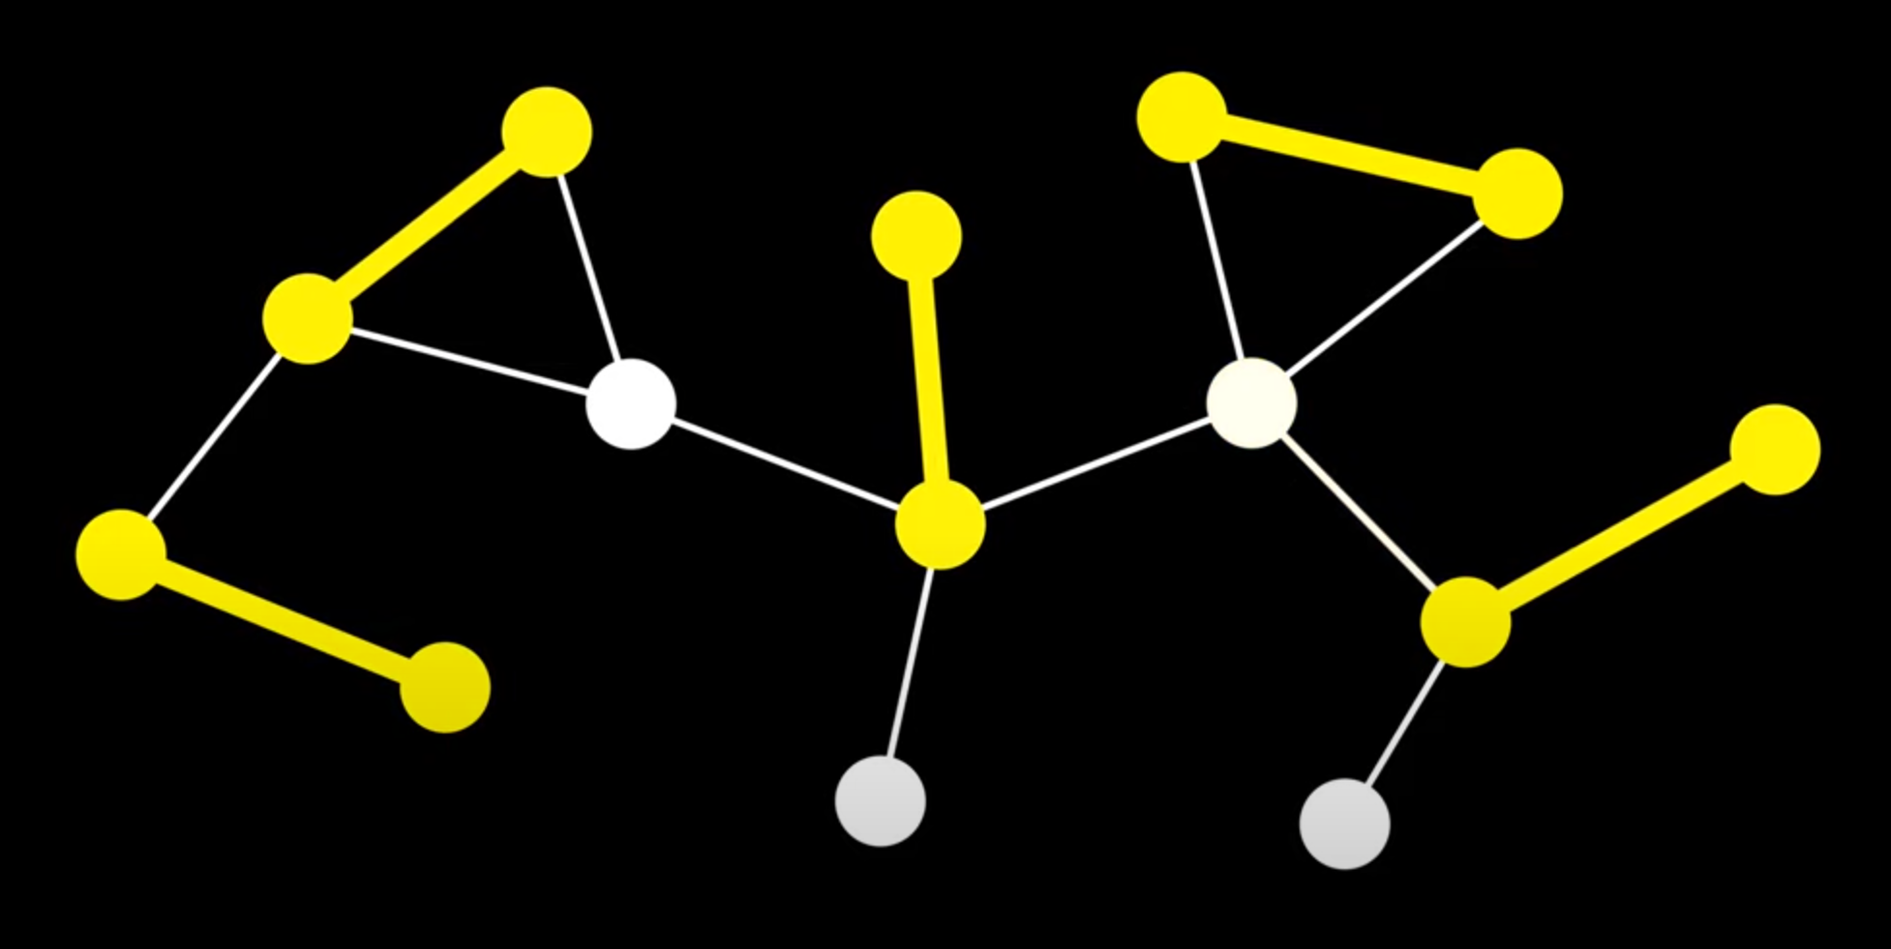
The Blossom Algorithm
Matching: a subset of edges such that no 2 share a vertex.
Maximum matching: it contains the most edges possible compared to other matching for the given graph.
Perfect matching: if each vertex in the graph has exactly one incident edge in this matching.

Slide 10
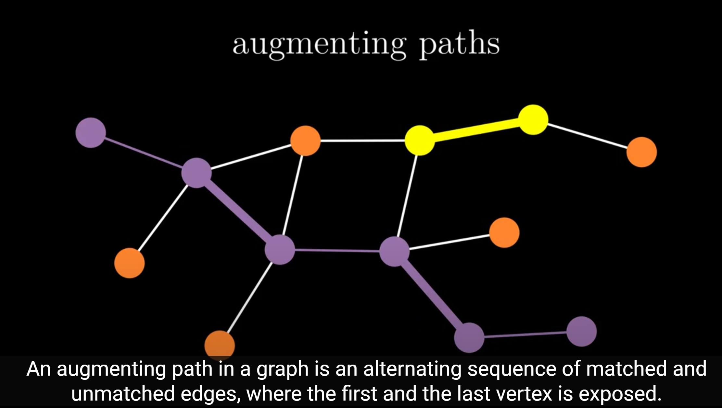
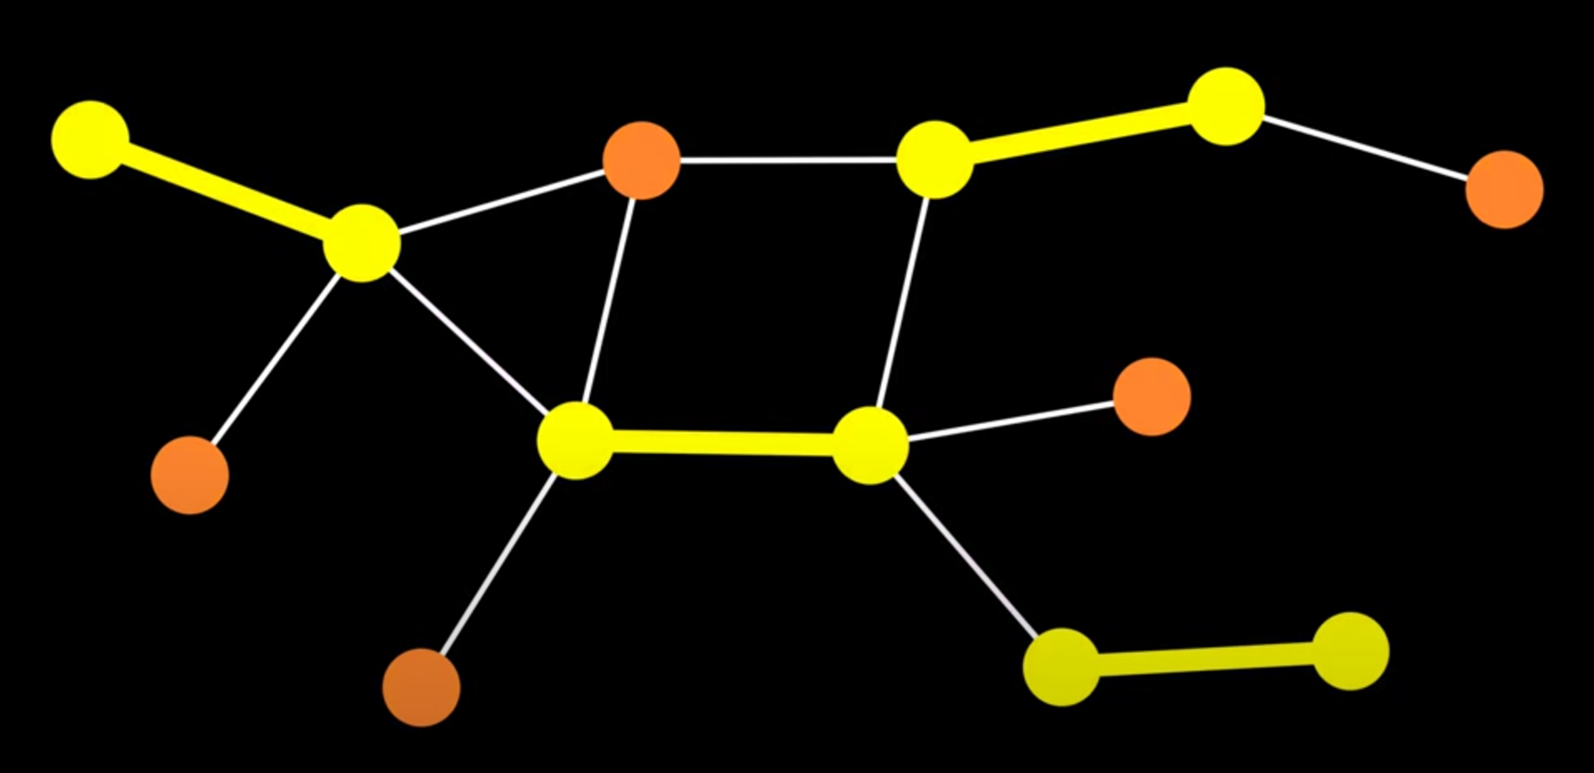
The Blossom Algorithm
Augmenting path:
Augmenting paths can improve(or augment) the size of the current matching by switching the matched and unmatched edges
We can prove that:
contains an augmenting path <=> matching is not maximum

Slide 11
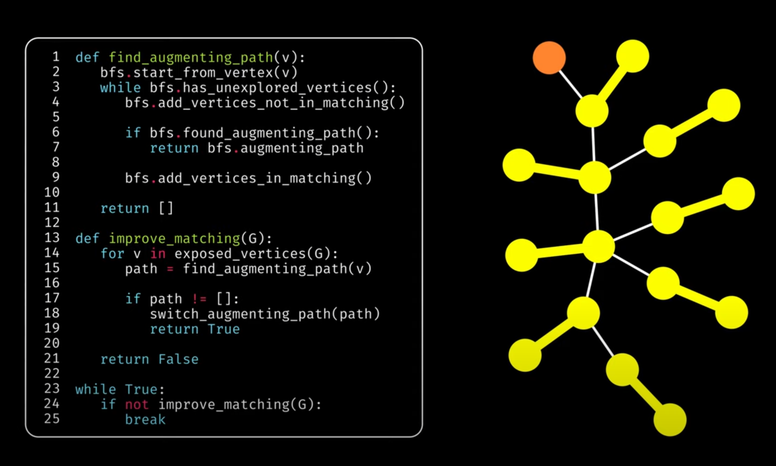
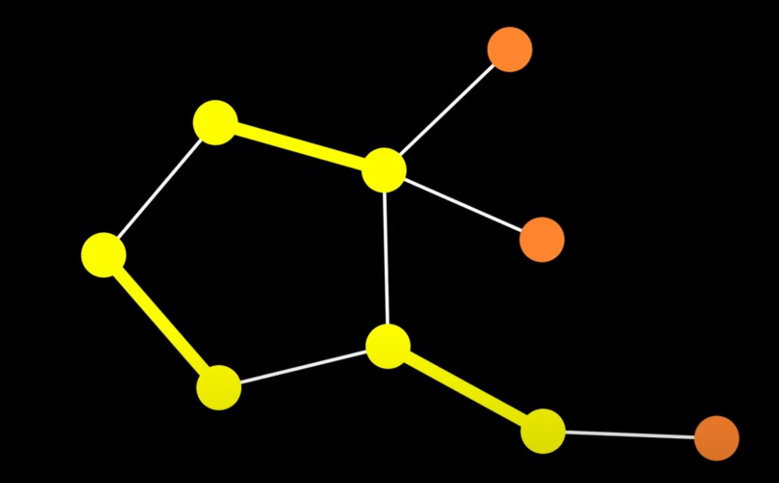
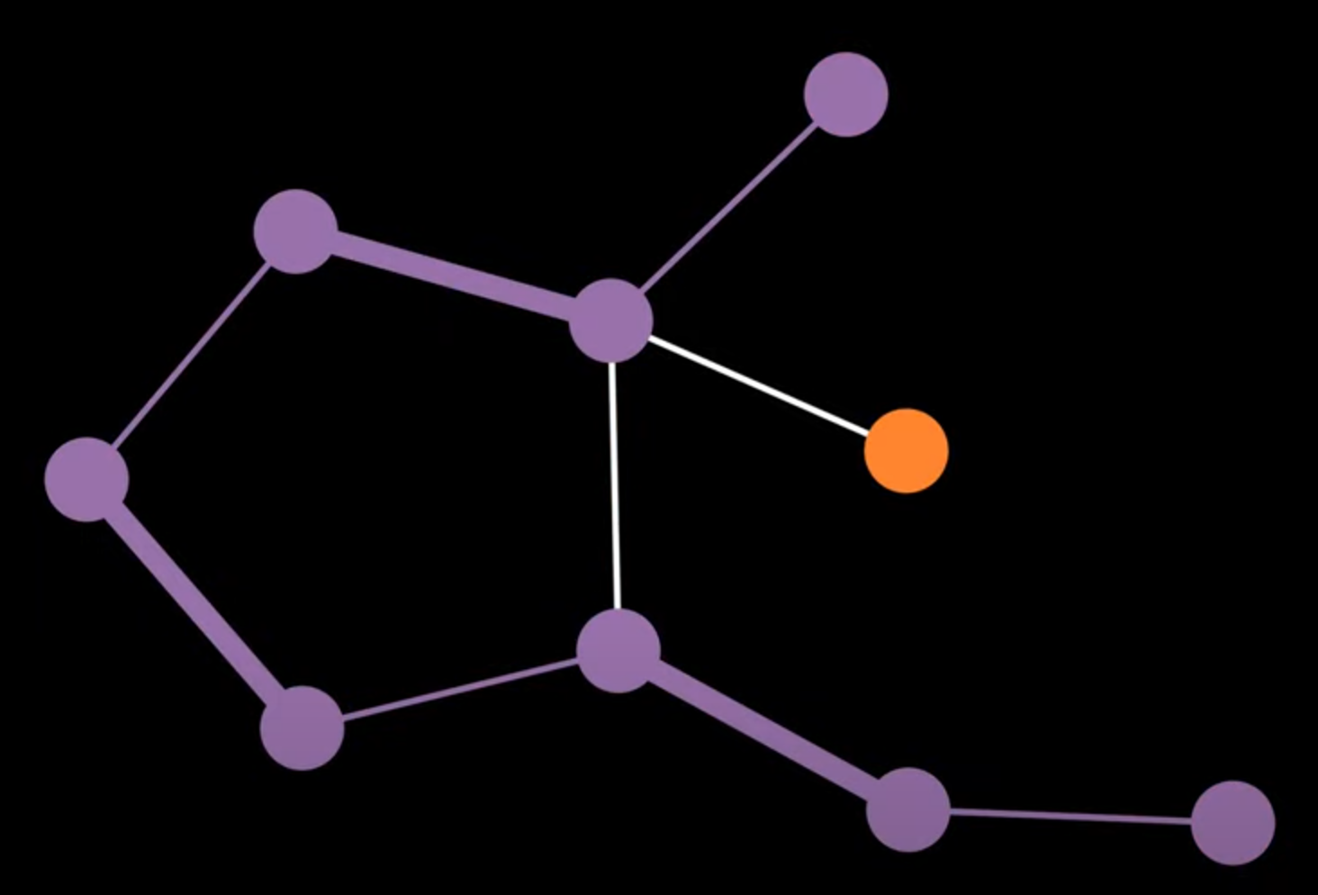
The Blossom Algorithm
We can repeatedly improve the matching using augmenting paths,until there are none left,at which point we know the matching is maximum.
However,Something may make the algorithm fail !
Since the augmenting path is longer than the shortest path,so is not found.

Slide 12
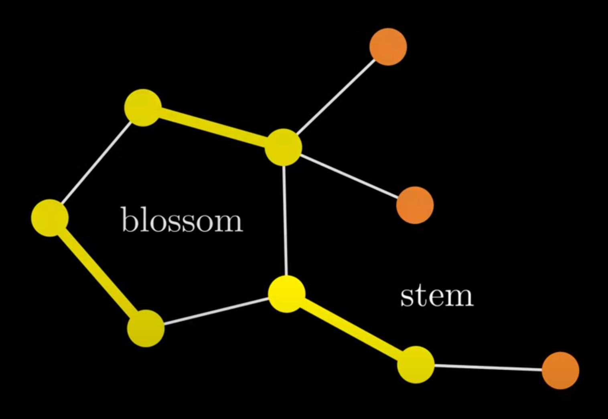
The Blossom Algorithm
The reason of failure——Blossom
Blossom: a cycle containing an odd number of “pseudo_nodes”, where a pseudo_node is either a vertex or another blossom.
Notes:
stem就是所谓的花托，就是从blossom上连出去的一条匹配边。

Slide 13
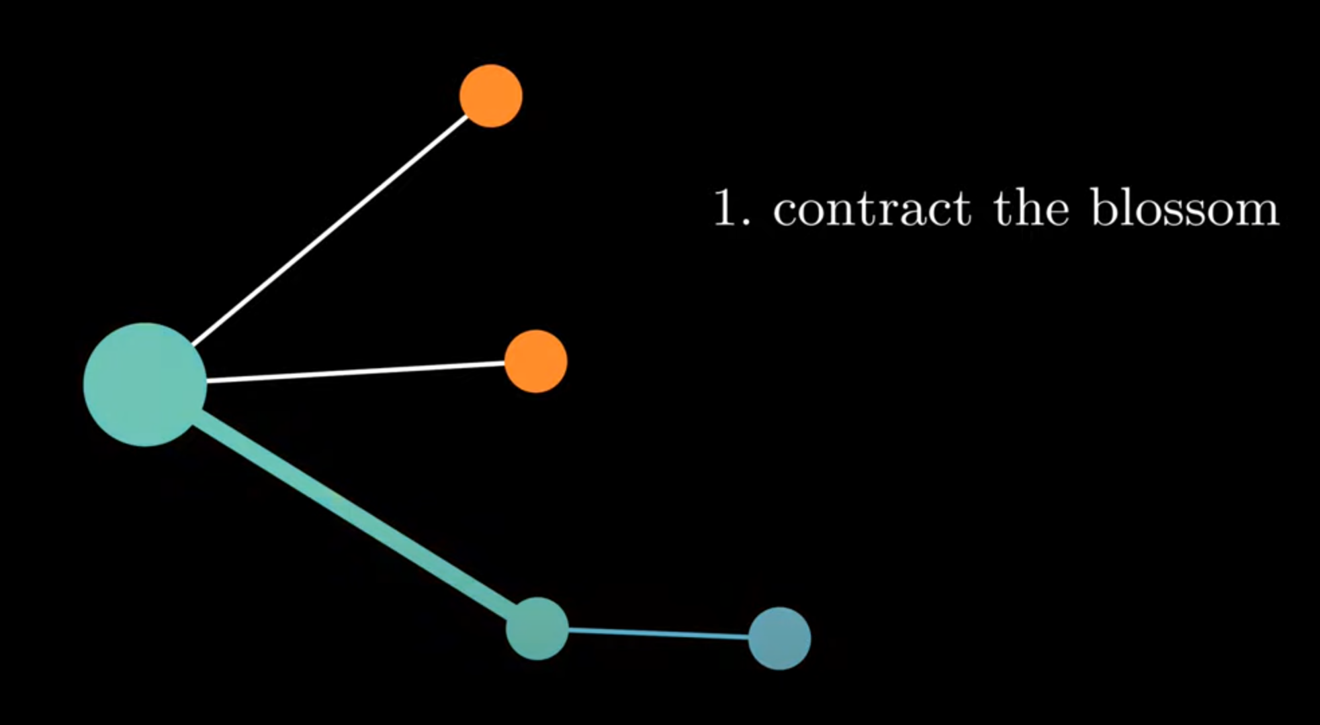
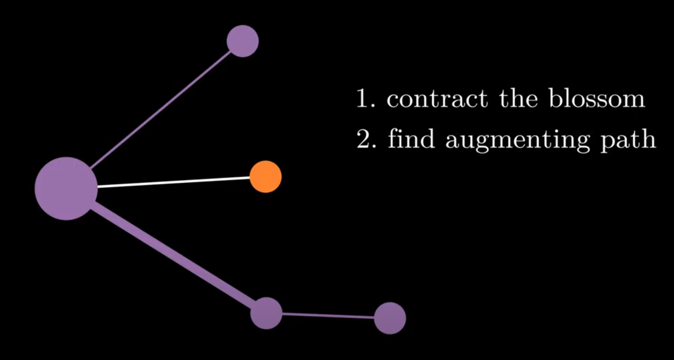
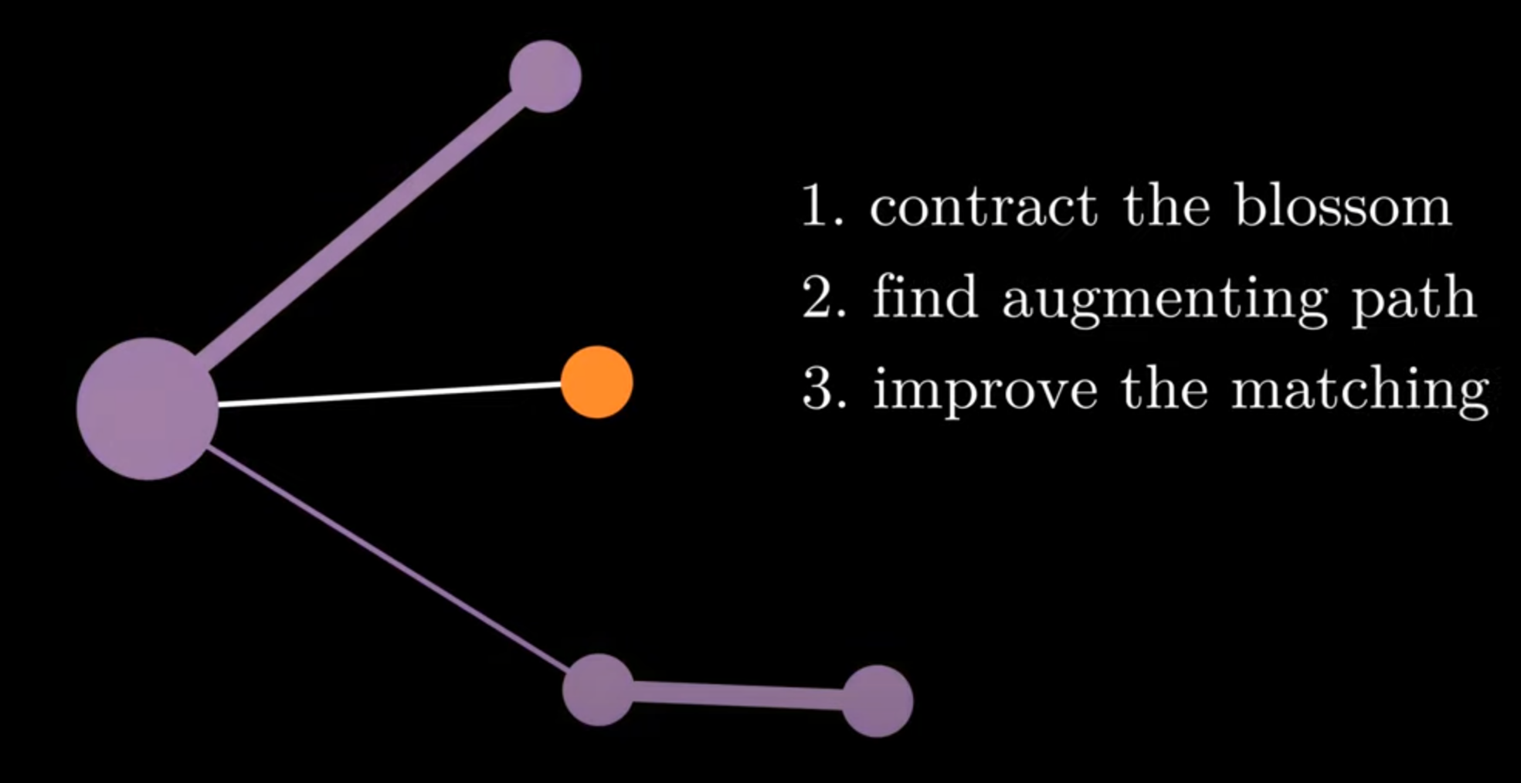
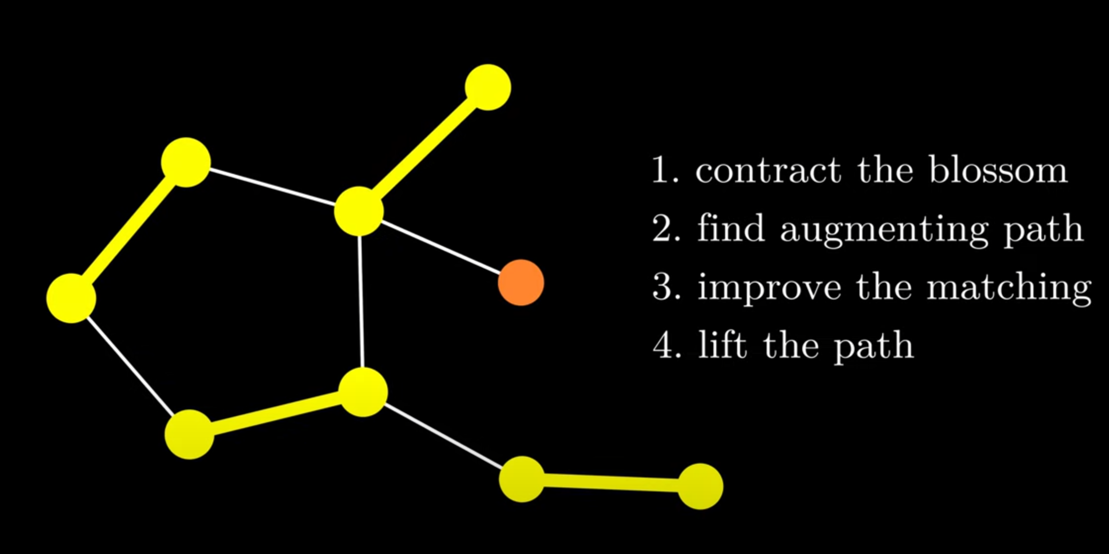
The Blossom Algorithm
We are relying on the fact that the graph has an augmenting path if and only if the contracted graph has an augmenting path!
How to handle the Blossom?

Slide 14
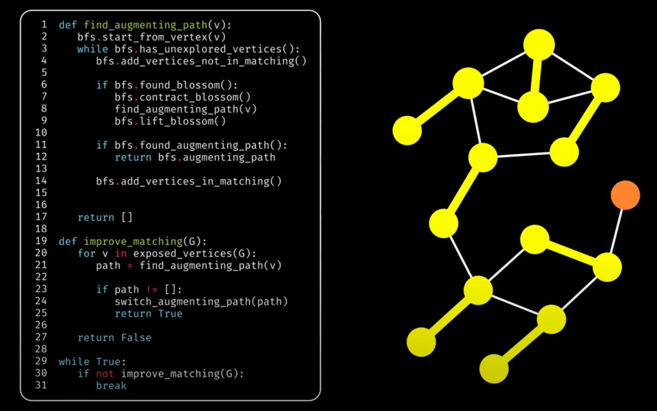
The Blossom Algorithm
Algorithm considering Blossom
Time complexity:
Naive solution:O(2e)
Blossom:O(e*v²)
Notes:
Time complexity:
Naive solution:O(2e) (每条边可以选择匹配或不匹配)
Blossom:O(e*v2)
①找到一条增广路最多遍历所有e条边，如果有花需要维护花上的点，最多维护v个点，所以是O(v*e)。
②枚举所有未匹配点作增广路，所以最多找v次增广路。
总共是O(e*v2)。

Slide 15
Perfect matching with weight
What we want? WMPM(minimum weight perfect matching)
In fact,minimum weight perfect matching <=> maximum weight perfect matching
Vertex labeling(顶标) and equality edge(等边)
Vertex labeling:For every vertex i,set l(i) as this vertex’s “weight”.And for every edge (u,v),
make sure weight(u,v)≤l(u)+l(v).
A equal subgraph is defined as a generate subgraph of the original graph with a set of legal vertex labelings, including all points but only those edges that satisfy weight(u,v)=l(u)+l(v).
We can prove that:
Under a set of legal vertex labelings, if a graph’s equal subgraph exists a perfect matching, then that match is the maximum weight perfect matching of the graph.
Define z_{u} as the vertex labeling of u,we define e(u,v) an equality edge iff (z_{u}+z_{v}=weight(e)),and at this time the edge labeling of edge e called z_{e}=z_{u}+z_{v}-weight(e)=0.
Notes:
这部分过于复杂，只简要介绍。
最大权匹配等价于最小权匹配，因为在最大权匹配算法中，将原先输入的每个weight w修改为max_weight-w那得到的就是最小权匹配了
最大权匹配算法的思路就是：用「等边」构成的增广路不断进行扩充，由于用来扩充的边全是「等边」，最后得到的最大权完美匹配仍然全是「等边」。

Slide 16
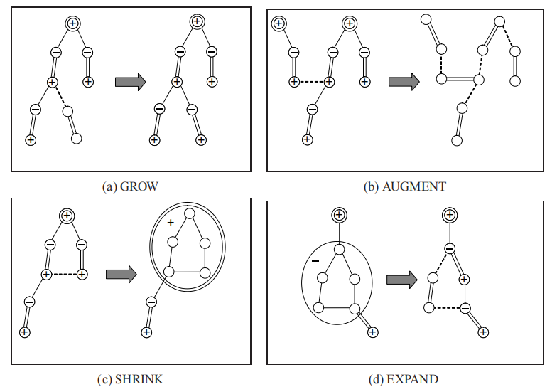
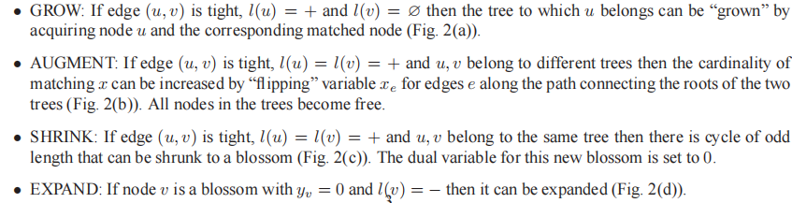
Perfect matching with weight
The step of the algorithm
odd and even vertex:
u⁻:odd vertex in an alternating tree(交错树).
u⁺:even vertex in an alternating tree.
u^{Ø}:an vertex not in any alternating tree.
(for a blossom B,which can be seen as a vertex,it is just the same)
Notes:
图中由等边连起来的就是交错树，算法运行过程中可能有多颗交错树同时存在

Slide 17
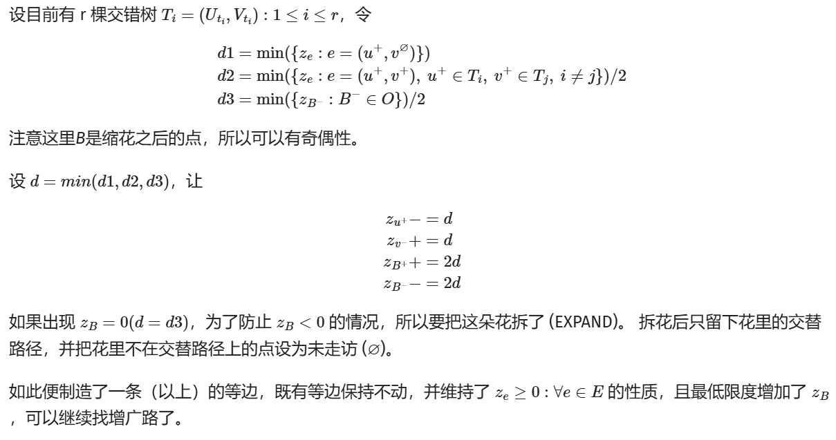
Perfect matching with weight
Sometimes we may not able to find a equality edge,so we need to adjust vertex labeling.
Notes:
详见OI wiki
其实这一步是算法的最关键部分，但太过复杂就简单一提

Slide 18
What We Do
Implement
MWPM
Build
Testbench
Analyze Performanse
Local Dijskra
Blossom V
Error Threshold
Time Complexity
Noise Model
UnionFind for Compare

Slide 19
02
Test Result

Slide 20
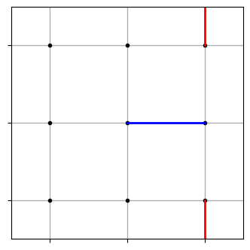
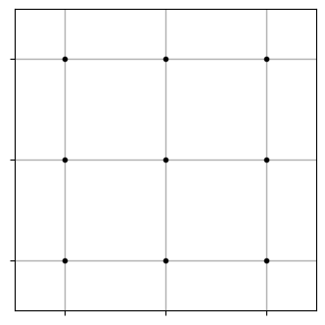
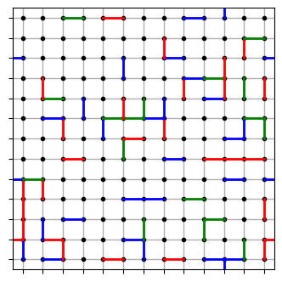
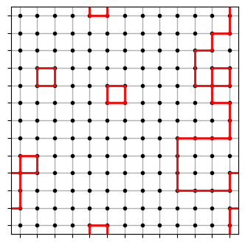
Error threshold
Error threshold is a physical qubit error rate p
physical error rate > p, bigger lattices only make thing worse
physical error rate < p, bigger lattices will help error correction
This indicate the scalability of decoders.

Slide 21
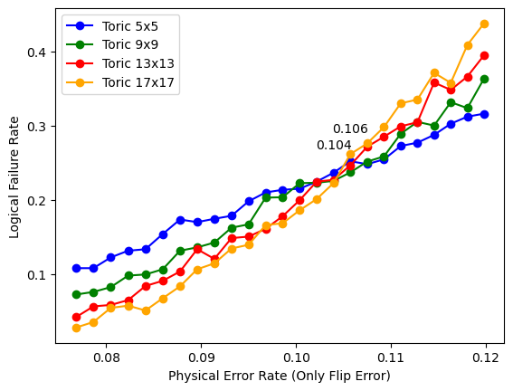
Error Threshold

Slide 22
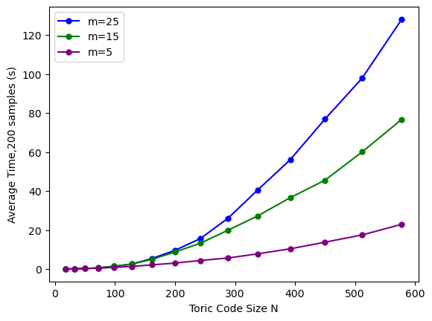
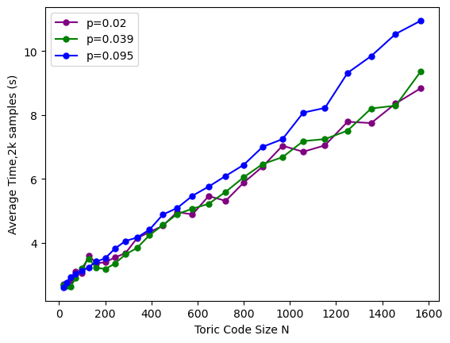
Time Complexity
Phase 3

Slide 23
03
Analysis

Slide 24
Trade-off of decoders
Logical Error Rate
(Accuracy)
Time Consuming
(Cost)
Union Find
MWPM 2021
MWPM 2023
Max Likelihood
Error Threshold
(Ability to handle large scale system)
Cellular automaton
Winner

Slide 25
Thanks
H Group
Surface Code Decoder
MWPM Decoder

